Slide 1
Tasks and Activities

Slide 2
Using Information in Tasks
Information is integral to completing tasks. The simplest model is to:
Find relevant information
Use that information to make a decision
Implement that decision
We call this the “Look-Decide-Do Model”

Slide 3
Information in Problem Solving
Select Source
Articulate Problem
Define Problem
Extract Information
Examine Results
Information access and use can be modeled in the context of problem solving.

Slide 4
Creating Information Artifacts in Tasks
External
Information
Resources
Artifact being created
Developer
In many tasks, the task involves creating an information artifact. That is often an iterative process.

Slide 5
Look: Tasks and Information
Information is integral for tasks
Role of Information in Tasks
Look-Decide-Do
More complex models are possible

Slide 6
Information Needs
When people ask a question, sometimes their true information needs are not obvious.
They may not know, or they may not want to admit, their own situation.
They may not know how to describe their situation
We might try to find out more about what they are thinking with an reference interview.

Slide 7
Complex Questions
Complex questions still can’t be answered by a search engine.
Some of those complex questions can be decomposed into parts, each of which can be answered easily.
Some other questions are so complex that they need to extended analysis and modeling.

Slide 8
Relevance
An information system should give user relevant information
However, determining exactly what document is relevant can get complex
It depends on the content
Is it on topic?
It depends on the task
Is it trustworthy?
It depend on the user
What have they already looked at?
What languages do they understand?
Is relevance all-or-none? Or, can there be partial relevance?

Slide 9
How do we Measure Relevance?
In order to evaluate the performance of information retrieval systems, we need to measure relevance.
Usually the best we can do is to have an expert make ratings of the pertinence.

Slide 10
Precision and Recall
Relevant
Not Relevant
Retrieved
Hit
False Alarm
Not Retrieved
Miss
Correct Rejection
Notes:
3
3

Slide 11
Precision and Recall (Cont’d)
Relevant
Not Relevant
Retrieved
a
b
Not Retrieved
c
d
a
a
P = --------------
R = --------------
(a+b)
(a+c)
Hits
Hits
P = --------------
R = --------------
Hits + False Alarms
Hits + Misses
Notes:
3
3

Slide 12
Precision and Recall (Cont’d)
Relevant
Not Relevant
Retrieved
4
6
10
Not Retrieved
1
89
90
5
95
100
4
4
P = -------------- = 0.4
R = -------------- = 0.8
(4+6)
(4+1)
Notes:
3
3

Slide 13
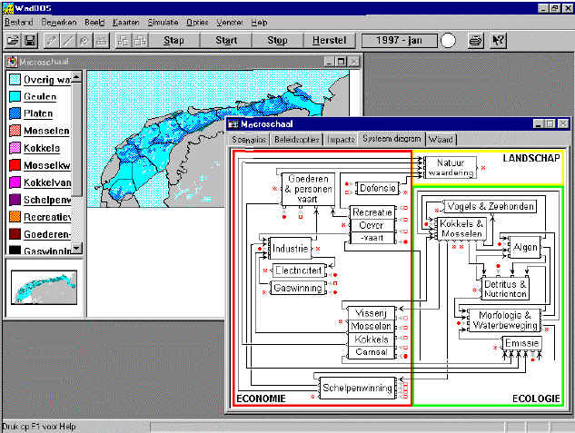
Decision Support Systems (DSS)
Typically, a DSS is provides a set analysis tools to model a complex scenario such as financial projections or environmental impact.

Slide 14
Group Decision Support Systems (GDSS)
Group decisions support systems can be though of a multi-user DSS systems though they may emphasize support of group discussion and interaction more than providing complex analysis tools.
Group interaction might range from brainstorming to Delphi Analysis.

Slide 15
Making Decisions
In the simple Look-Decide-Do Model, once information has been collected, we move to making a decision.
Decision making can involve either informal or formal methods.
A “gut reaction” would be informal
Following a Decision Tree would be a formal method.

Slide 16
Decision Trees
Minimum systolic blood pressure > 93
yes
no
Age > 62.5
no
LOW
yes
Sinus Tachycardia Present
HIGH
yes
no
LOW
HIGH
Rules for determining whether a patient has high risk for a heart attack.

Slide 17
Game Theory for Multi-person Decisions
Game Theory describes how a person might make evaluate alternatives in a multi-person task. Players may have different payoffs.
The Prisoner’s Dilemma is a famous example. There are two prisoners who committed a crime together. They can go free (+3) if neither confesses, but if one confesses and the other doesn’t they may get different penalties (-5/-1). What will they do?
A Not Talk
A Talks
B Not Talk
5/5
-1/5
B Talks
-5/-1
-3/-3

Slide 18
Problem Solving
Find a course of action to accomplish a goal.
There are different level of problem solving
Relatively simple problems, such as arithmetic can be decomposed into part each of which can be easily solved.
More complex problems ma

Slide 19
Planning
Two levels of planning
Strategic planning
Scheduling
Incorporating uncertainty in planning
Even with careful planning there can be unexpected events and failures. In those cases, we can use:
Bricolage and Improvisation

Slide 20
State Machines
Several formal models have been developed for describing processes. The simplest of these are state machines.
These describe activities as a sequence of states. In this representation, the activity must be in one of several states.
The state machine is describes the transitions between states.

Slide 21
System Analysis
We want to better understand complex systems such as a large business.
One principle is to follow the data flow. This makes us emphasize the procedures.
In other cases, we may want to build a complex system for scratch. In that case, we might use object-oriented design. Object-Oriented design follows representations which are also embodied in the Object-Oriented Data Model.

Slide 22
Object-Oriented Data Model
The OO model extends the ER model. The Classes have:
Methods
Specific procedures associated with the data in a class.
Inheritance
There can be a hierarchy of classes and attributes and methods can be inherited.

Slide 23
Unified Modeling Language (UML)
UML combines several types of models for modeling different aspects of systems.
Sequence Diagrams
Activity Diagrams
Use Case Diagrams
Statechart Diagrams
Many applications including system analysis and object-oriented program development.

