Slide 1
Human Cognition, Emotion and
Interaction with Information Systems

Slide 2
Cognitive Structure and Representation
Human information processing considers how information is captured, stored, and retrieved.
A common structural model of human cognition assumes that there is both short-term and a long-term memory.
Working memory
Sensation
Action
Attention
Long-term memory

Slide 3
Human cognition is very different from typical computerized information systems
Many models of human cognition suggest that it is similar to information processing by computers, but there are many ways in which it seems different from that.
People often don’t use Aristotelian categories.
People often don’t seem to reason with logic. Are people “rational” in decision making?

Slide 4
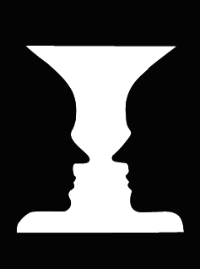
Sensory Perception and Attention
Pre-iconic perception such as the gestalt face-vase illusion
Selective attention seems to involve adding more cognitive resources for processing sensations and it is guided by higher level cognitive processes.
People often attend more to items and events which reinforce their expectations.
Yellow letters on a blue background is the most visible color combination because of the cones in the retina

Slide 5
Associative versus Structuralist Learning
The emphasis on memory structures doesn’t explain very well how human learning works.
A lot of human learning seems to be based on associations. For instance, we learn that eating stops us from being hungry.
Unsupervised learning
Custering
Supervised learning
Teacher gives feedback and rewards
Associative learning is found in machine learning such as learning in neural networks.
Do we learn language by association or by innate rules?

Slide 6
Attitudes and Beliefs
Many decisions don’t seem to be based on a logical analysis. Rather, they seem to be based on attitudes.
Attitudes seem to be emergent. That is, they are the result an accumulation of factors. For instance, political convictions are often hard to change by argument.

Slide 7
Motivation and Emotion
Human information processing is not all logical inference. It interacts with biological needs and emotions. Beliefs often reflect human needs and self-interest.
Emotions are transient. They are based on generalized physiological arousal accompanied by an inference which labels the type of emotion. In other words, fear and hate are not physiologically different, but differ in what a person infers.
Emotion also causes a reduction in processing capacity.

Slide 8
Persuasion
Fear is often persuasive.
Wear your seatbelt…
Don’t smoke…
Don’t drink and drive…
Or, face terrible consequences
Is this an emotional appeal or an informative one?

Slide 9
Interface Development vs Interaction Design
There are many types of interfaces in a complex system but when we talk about interface design, we usually mean the human-computer interface
Because interface design seems most often associated with screen layout, the phrase interaction design is often used.

Slide 10
Making Application Programs Easy to Learn
Interface Metaphors
Can be a helpful
A word processing system works like a typewriter
Can be harmful
In a word processing system the words wrap to the next line when you come to the end of a line
Affordances provide clues
about the functionality of
a device.

Slide 11
Interface Engineering
Can we set the parameters of an interface the same way that an engineer follows equations when building a bridge?
One example is the Keystroke Level Model. This tries to predict the time to complete specific commands with keystrokes and mental planning time.
Works well for simple tasks, but not for complex ones.

Slide 12
Evaluation of Interfaces/Interaction
Three main approaches
Usability testing
Either experiments or discount usability
Highly replicable but not necessarily realistic
Field studies
Watching users in natural environments
High generality
Heuristic evaluation
Apply simple checklists or
Relatively easy and cheap to conduct

Slide 13
Cognitive Bias in Choice Kahneman and Tversky
People may drive across town to save $5 on a $15 calculator but not drive across town to save $5 on a $125 coat.
Someone argues that cigarette smoking is not unhealthy because his grandfather smoked three packs of cigarettes a day and lived to be 100. The grandfather's health could simply be an unusual case that does not speak to the health of smokers in general.
The president gives the State of the Union address and says that walnut farmers need a special farm subsidy. He points to a farmer in the balcony who is sitting next to his wife and explains how the farmer will benefit. Others who watch and discuss later agree that the subsidy is needed based on the benefit to that farmer. The farmer, however, might be the only person who will benefit from the subsidy. We don't know if walnut farmers in general need this subsidy.

Slide 14
Conceptual Models and Mental Models
Conceptual models to teach complex ideas. Conceptual models are often similar to information system representations
Equations, schematic images
People seem to develop mental models as internal representations for complex processes
How does a car work?
How does the Internet or search engine work?
What will my friend do after class tomorrow?
But, it is hard to determine the cognitive representation for mental models.

Slide 15
Attribution and Stereotypes
People develop expectations about the behavior of other people all the time.
People tend to believe a plausible narrative if it is consistent with their other knowledge and beliefs.
If there was a bank robbery and there are two suspects – a doctor and a previously convinced felon who are we more likely to believe is guilty?
These expectations can often be wrong. Perhaps people need more subtle models for developing expectations about the behavior of others.

Slide 16
Recommendation Systems and Social Search
In early search engines, search results were based entirely on the similarity of the query terms to the document terms.
Current search engines also consider the “similarity” of the user to other people.
Collaborative filtering
Other people refer content to you based on their impression of your interests
Social filtering
Predictions based on implicit or explicit behavior (e.g., ratings) of others
http://www.ratingzone.com/

Slide 17
Ratings and Recommendation Services
In some cases, it can be difficult to collect explicit preference ratings from a person.
Implicit ratings could be easier. That is, we could just record your behavior.
For a company like Amazon there can be too much data. What to count?
Books bought
Pages viewed?
Books returned by search hits?

Slide 18
Predict the preference on V6 for P3
 | Video 1 | Video 2 | Video 3 | Video 4 | Video 5 | Video 6
Person 1 | 5 | 1 | 7 | 4 | 2 | 6
Person 2 | 2 | 7 | 3 | 2 | 7 | 1
Person 3 | 6 | 3 | 6 | 5 | 1 | ?
Ratings on a 7 point scale

Slide 19
Correlation Coefficients
Correlation
Coefficient
p1 v p2 -0.80
p2 v p3 -0.90
p1 v p3 0.83

Slide 20
NetFlix – Million Dollar Competition For Improving Predictions
http://www.netflixprize.com/
Why is it worthwhile for Netflix to do this?
First run movies are especially expensive for Netflix to license.
If they can drive demand to less familiar (less popular and less costly) films then they may have.
Lower costs
More satisfied customers

Slide 21
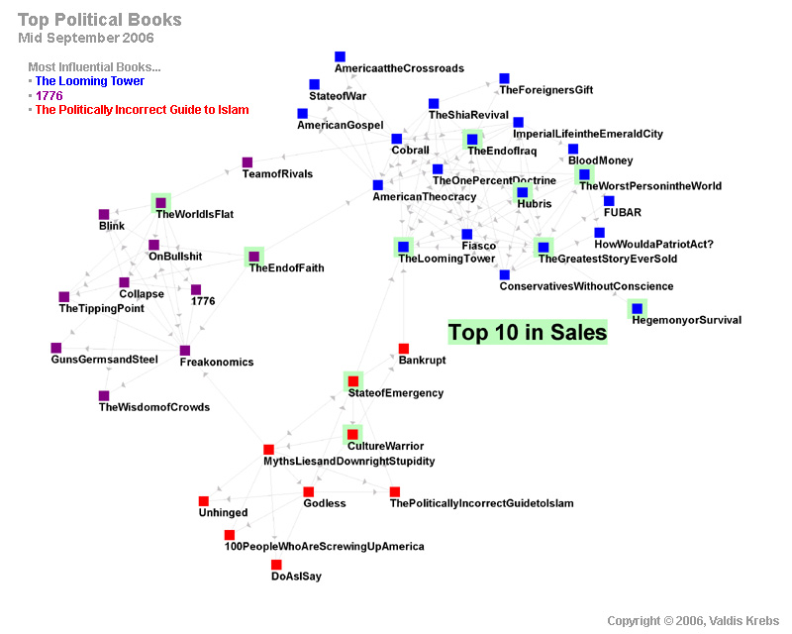
Multidimensional scaling of co-occurence of book purchases. The books fall into three groups. Liberal (blue), conservative (red), and neutral (purple).
From Vladis Krebs, orgnet.com

Slide 22
Making Predictions about Preferences Factors to Consider
What do we mean “other people like you”
Behavior
Demographics
Age, Gender
Transitory-states
Hunger, Emotion
Knowledge
Privacy issues
Related to psychological prediction

