Slide 1
Social Interaction and Education

Slide 2
Social Interaction and Cognition: Two Sides of the Same Coin?
Paradox: While we generally praise freedom of the individual, we also believe that “no person is an island”.
On one hand, human cognition is affected by social constructions such as language.
On the other hand, the human cognition shapes social interaction.

Slide 3
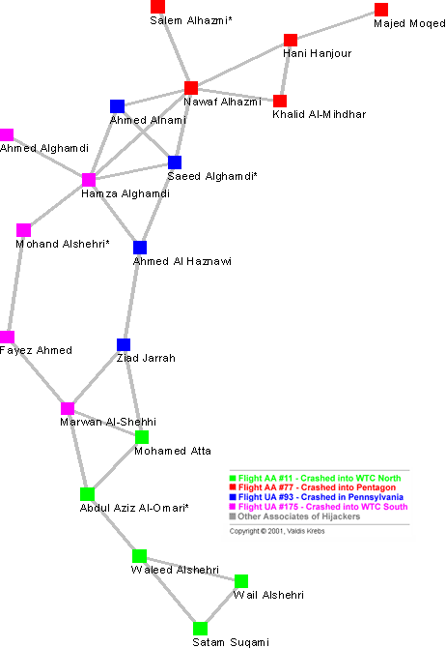
Social network of the 9-11 hijackers. Note that there are few links between the groups.
From First Monday, “Uncloaking Terrorist Networks” by Vladis Krebs.

Slide 4
Social Networks
The simplest social networks have just nodes and links.
Formally, social networks can be described with graph theory.
Degree of separation is the distance between two people.
Social networks can be specified with XML such as FOAF (friend of a friend).
Social networks affect the diffusion of information. But many real communication networks are more complicated with many different types of communication such as mass media.

Slide 5
Small Groups and Decision Making
Media Richness Theory: Communication modality (e.g., telephone, email, video) can significantly affect interaction.
People adapt to the limitations of communication modalities.
Emoticons and abbreviations help to overcome the limits of text messages.

Slide 6
Effects of Communication Modality
People adapt to the limitations of communication modalities.
Emoticons and abbreviations help to overcome the limits of text messages.
Media Richness Theory
The richness of the medium is more important for ambiguous messages.
There tends to be more balanced participation in group discussions in less rich environments.

Slide 7
Social Perception and Social Learning
We actively interpret other people’s actions and intentions. We then judge whether a person in responsible for an action.
We seem to apply several types of probabilities (Bayesian priors) in these judgments.
The typicality of the persons actions for that situation
Consistency with the person’s previous actions.
Possible motives for the actions.

Slide 8
Reputations and Trust
Reputation and trust are built on predictability and expectations.
Reputation is formalized in branding.
Contracts formalize trust. There has to be a mutual exchange and penalties for non-compliance.
Can develop “trust networks”. If you trust somebody and I trust you, should I trust that other person?

Slide 9
Organizations
Classic organizations are hierarchical
Hierarchy provides a means of control. Information systems provide other ways to increase control.
Information systems break down hierarchies
From the top, the span of control can be much greater
Individuals have can easily interact and control distance processes.
The result is a grow in non-hierarchical (e.g., object-oriented) and virtual organizations.
This means organizations focus on core-competencies and outsource non-core activities.

Slide 10
Culture and Community
Culture often has adaptive characteristics
Balinese water temples support a
complex system of water management
The adaptive aspects are not always
apparent.
Culture changes slowly. In changing
environments, cultural traditions can
be non-adaptive. Should the culture change?
Information Systems/Technology can support culture
“From Muslims who use their phones to point them toward Mecca, to Roman Catholics who collect text messages from the Vatican, religious observers across the globe are turning to their cell phones for aid and inspiration in practicing their faith.” http://www.wired.com/culture/lifestyle/news/2004/08/64624

Slide 11
Society
Society can be viewed as a set of interlocking sub-systems: (roughly as): economics, politics, and culture, legal
Society defines rules and norms for individual action.
Social aspects of information use will be discussed in a few weeks.

Slide 12
Social Decision Making
Groups, organizations, and societies have many ways of making decisions.
Consensus, unanimity, majority, plurality
Voting
Democracy requires informed citizens
Plurality rule voting isn’t always optimal when with multiple candidates
What security standards should be set for e-voting?

Slide 13
Education
Education is attempts to impart the skills and values to function in society.
Learning which emphasizes the derivation and development of concepts is termed ‘constructivist’. This is contrasted to rote learning.
Constructivist learning
Is it better to learn multiplication by deriving each answer or by memorizing tables?
Learning can be either individual or social. In social learning, people learn from each other and motivate each other’s learning.

Slide 14
Instructional Design
Instructional design goes beyond individual tools
Single tools, Course modules, Course, Curriculum
Skills needed beyond domain knowledge
Self-management
meta-cognition
understand learning tools an environments
Bloom’s taxonomy for levels of learning
Knowing, Evaluation, Synthesis, Analysis, Application, Comprehension, Knowledge

Slide 15
Tutoring with Student Models
Ideally a tutor has considers the student’s level of knowledge in providing feedback
What are good techniques as representations for a student’s knowledge?
Student models are like user models but it is often difficult to judge what a person knows or exactly why they made an error. ½ + ½ = ¼
This is part of the broad issue of educational assessment.

Slide 16
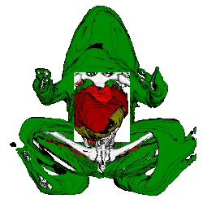
Tools to Support Learning
There are many simple widgets to support learning
“Manipulatives” provide
educational interaction
with visual models which
replace physical systems.
Simulations and “serious
games” can provide context

Slide 17
Information Systems and Education
Information systems are better integrated with educational goals, not driving them
Digital libraries to support “inquiry based learning”
Speech processing supporting reading.
Teaching how to summarize: Summary Street

Slide 18
Computer-Mediated Learning
Dimensions
Synchronous vs Asynchronous
Local vs Remote vs Hybrid
Individual vs Group
Media-rich vs Media-poor

Slide 19
Information Literacy
What skills related to information use and access should be taught?
Understanding the way information should be organized.
Information ethics go beyond law.
Use of intellectual property without permission or attribution.
Plagiarism is related to, but different from, copyright.
Considering the motivation beyond a message.

