Slide 1
Text and Text Processing

Slide 2
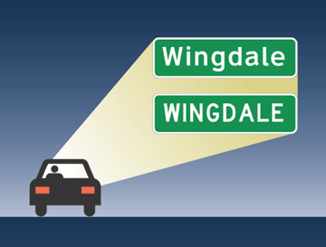
Fonts
Clearview (top) is a new font developed to make highway signs more readable. At highway speeds using headlights, the Clearview font is significantly more readable than the font traditionally used for highway signs.

Slide 3
OCR Optical Character Recognition
Recognition Process
Looking for features
Versus matching a template
How much linguistic and world knowledge is needed for processing
Collaborative corrections

Slide 4
Reading
Teaching reading.
Close reading.
Literacy

Slide 5
Authorship of the Federalist Papers
The Federalist Papers are a series of 30 essays published in newspapers to argue for the adoption of the U.S. Constitution. James Monroe and Alexander authored almost all of them but for some of the essays, the identity of the author them was lost.
Because each author used a distinctive set of terms, the authorship was able to be determined by a Bayesian statistical analysis of the words.

Slide 6
Text Processing
Spell-checking
Edit distance
Parsing
Summarization
Text categorization

Slide 7
Information Extraction
Texts (e.g., Web pages) have a lot of information but it not well structured. If we could extract that information, we could develop better question answering systems.
Named-Entity Extraction
Template Matching

Slide 8
Text Document Retrieval
Literally

Slide 9
Vector Model
Words carry a lot of the meaning of documents. Thus, we can represent the meaning of a document fairly well with a list (i.e. a vector) of terms.
Queries can be also be represented as vectors.
Weighting terms with term frequency or document frequency.

Slide 10
Other Text-Retrieval Techniques
For Web pages, the hyperlinks are also an indication of similarity. This was captured in Google’s PageRank Algorithm
Learning from users.
Social network links (what your friends are looking for)

Slide 11
Retrieval Interfaces

Slide 12
Indexing the Web
Spidering

Slide 13
Search Engine Business Models
Advertising
Ad-words
Search engines linked to other services

Slide 14
Automated Question Answering
Recall the discussion of answering reference questions
Automated question answering
Question categorization
Finding the answers
From a knowledgebase
Synthesizing answers from the Web

Slide 15
Sentiment Analysis and Blog Retrieval
There is can be a great advantage to knowing what’s the populace is thinking.
Example of difficulty.
Valence detection

Slide 16
Summarization
What do we mean by a summary
Techniques
Extractive summarization
Teaching summarization

Slide 17
Translation
Surface translation
Pair-wise translations versus a common, language-neutral representation.
Try a round-trip translation
Increasingly, statistical methods are used for improving translations.

Slide 18
Speech Processing
Representing speech with Phonemes
Basic sound units. In English there are about 56 phonemes
Vowels vs. consonants
Types of consonants: plosives, fricatives
Many applications
Speaker identification
Word spotting
Language recognition

Slide 19
Speech Recognition
Digitize the sound waves
Spectrograms: From waveform to frequency
Can we find the phonemes? Look for “formants”

Slide 20
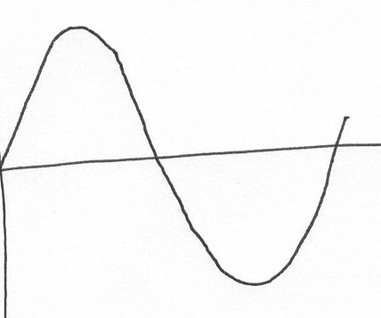
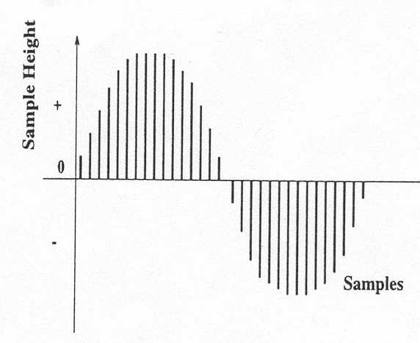
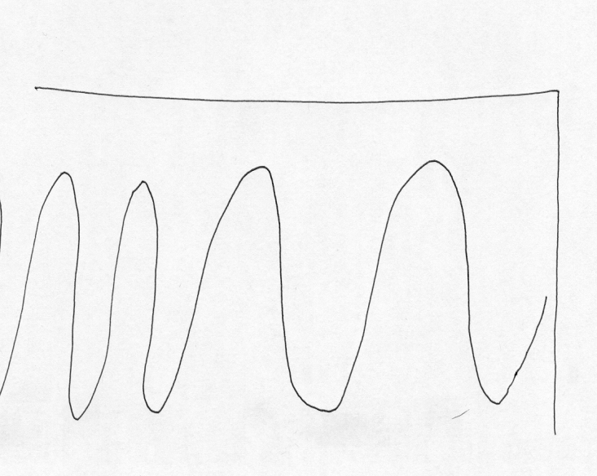
Automatically processing speech:
Creating a spectrogram
Original Sound Wave
Sampled Sound Wave
Wave Representation
Frequency Representation

Slide 21
Phonemes
Sounds which differentiate meaning
Bit, But, Bat, Bet, Robot
Types of Phonemes
Vowels
Consonants
Fricatives – f, s
Nasals – m, n
Plosives p, t, k
Flap – tt (utter)
Non-English sound
Trill – (Spanish perro)
Click (!kung)

Slide 22
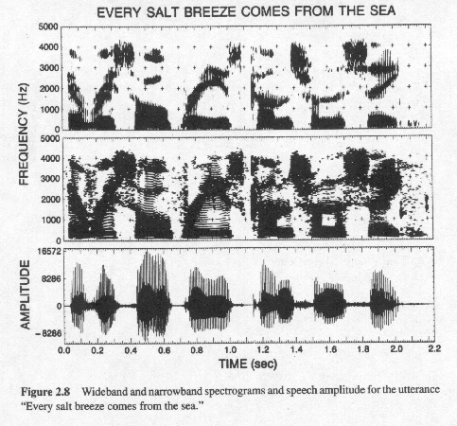
Processing Speech to Find Formats

