Slide 1
Multimedia and Hypermedia

Slide 2
Audio Media
Sounds
Music
Speech
Video
Hypermedia

Slide 3
Visual Media

Slide 4
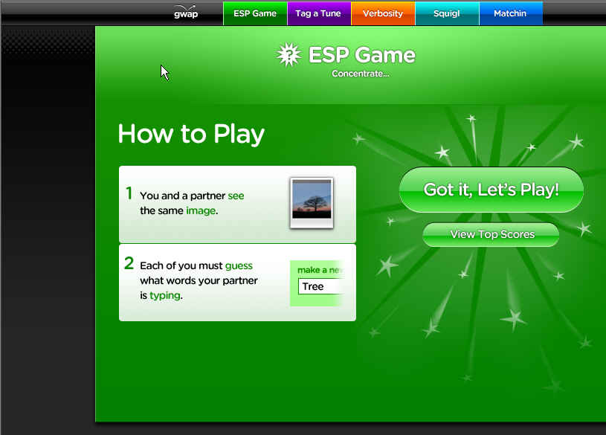
ESP Game – For tagging images (gwap.com)

Slide 5
Visual Languages

Slide 6
Visualization

Slide 7
Speech Processing
We discussed speech processing last week.

Slide 8
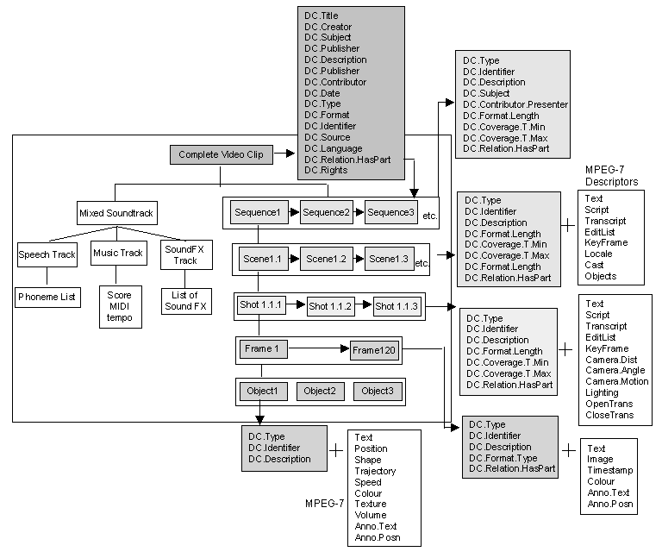
MPEG7
Layers of MPEG-7 Standard for Film and Video

Slide 9
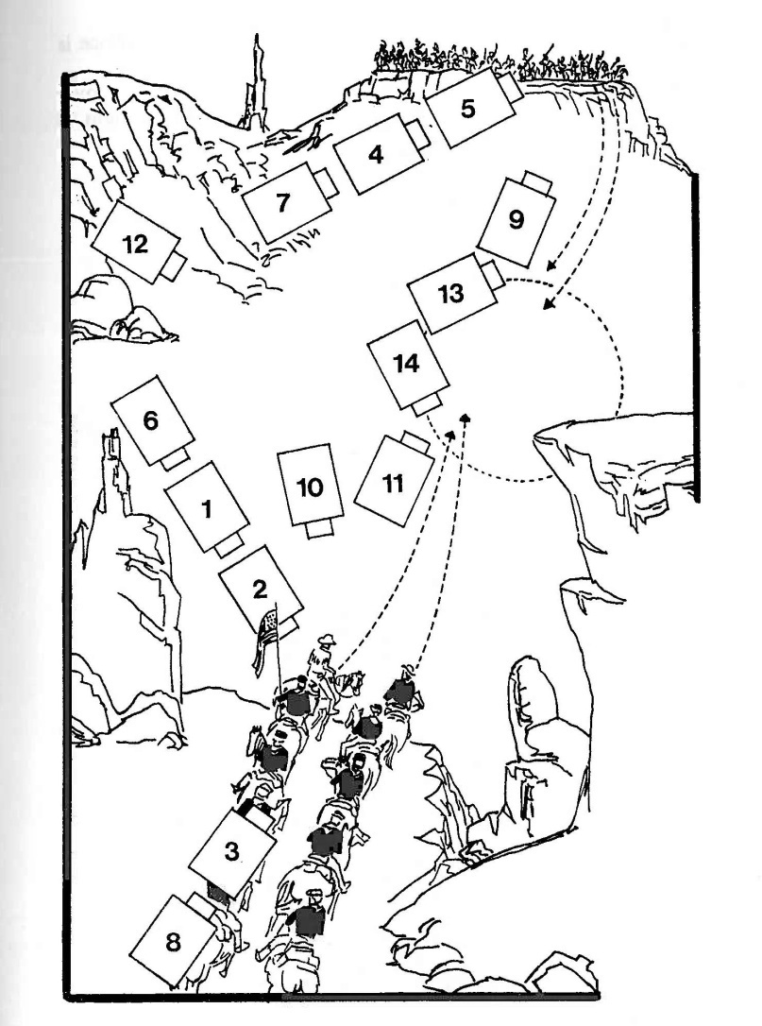
“Grammar of Film”
The sequence of shots for a cowboy movie as two groups approach other.

Slide 10
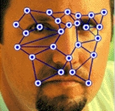
Face and Person Recognition
Beyond Face Recognition: Include gesture, posture, etc

Slide 11
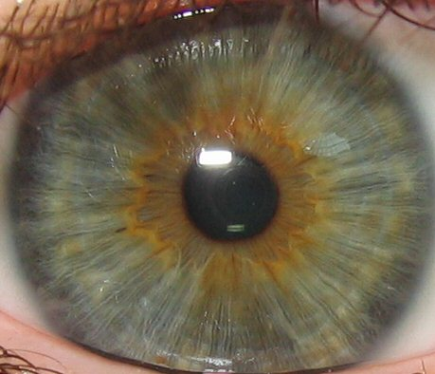
Biometrics: Iris Scanning
The iris is more distinctive than fingerprints.

Slide 12
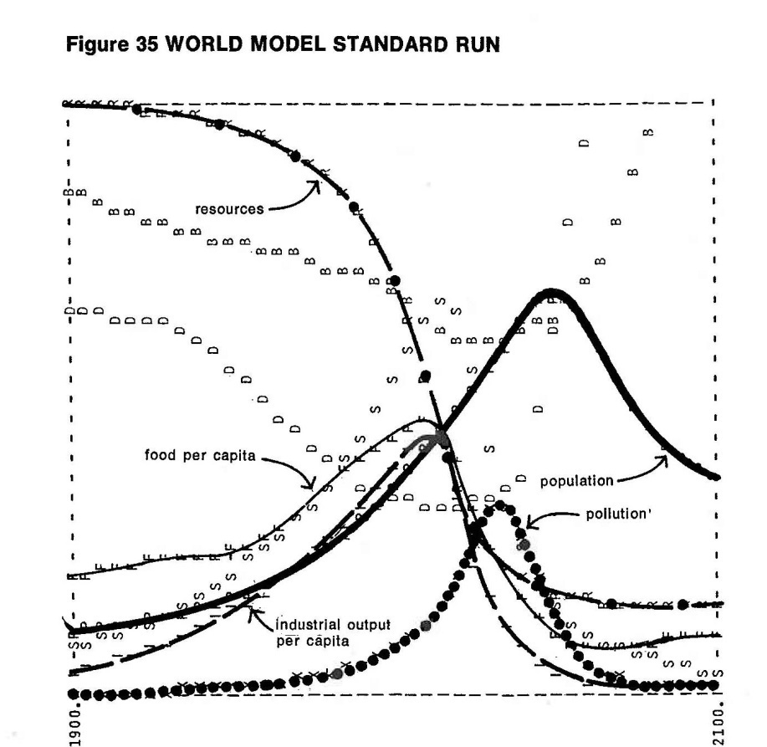
Simulations
Club of Rome, Numerical
analysis, and Malthusian Models
Is it zero-sum?
It didn’t make successful
predictions

Slide 13
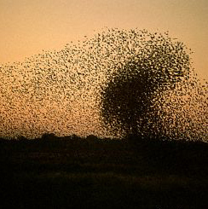
Swarm Intelligence
Bats exiting a cave in Texas at sunset.
Swarms like this can be simulated with each animal applying three simple rules relative to other animals in the swarm.

Slide 14
Games
Serious games

Slide 15
Cyber-drama

Slide 16
Augmented Reality

Slide 17
Virtual Reality

